Slide 1
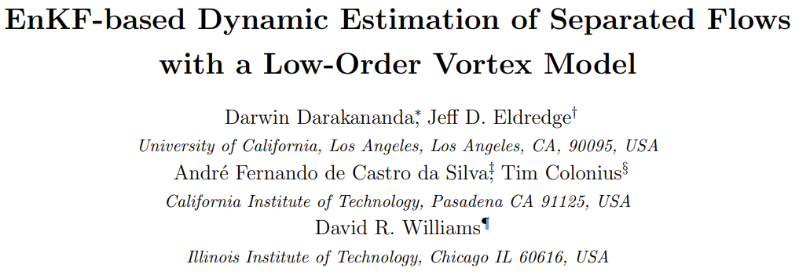
ENAE788L: Optimal Estimation
3 Dec 2024
Joe Mockler

Slide 2
Paper Outline
Introduction and background
Vortex modeling
Ensemble Kalman Filter (EnKF)
Goals of the work
Approach
Dynamic and measurement models
Filter application + variance inflation
Simulations
Conclusion and future directions
Appendix

Slide 3
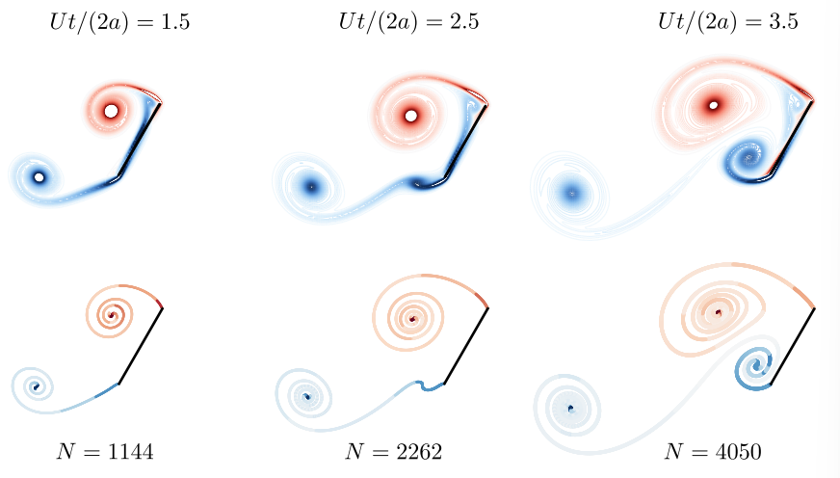
Background: Vortex Modeling
In unsteady aerodynamics, vortex models help simplify circulating flow discontinuities → have various levels of model fidelity [2]
Describe position, strength of vortices.
Describe interactions / convection
Have different discretization schemes
Shedding and aggregation an active area of research

Slide 4
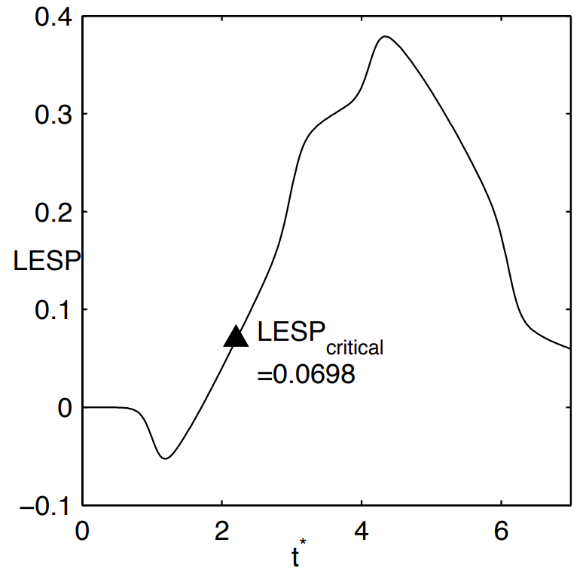
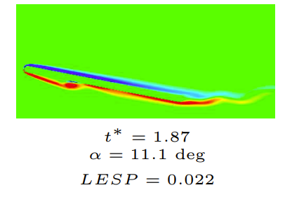
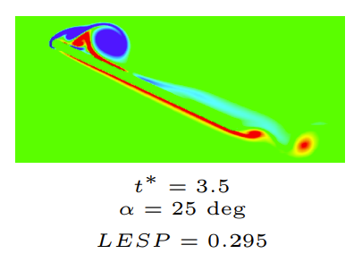
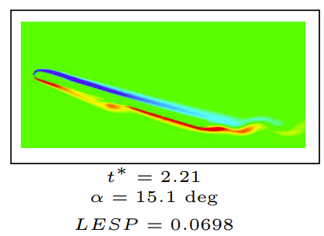
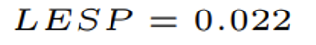
Background: Vortex Modeling
Shedding vortices is governed by the Leading Edge Suction Pressure (LESP). Sufficiently low pressure sheds a vortex. [1]

Slide 5
Background: Vortex Modeling

Slide 6
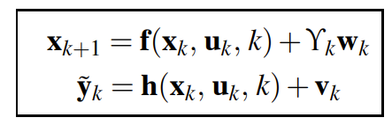
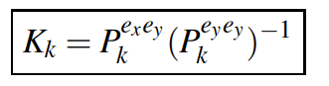
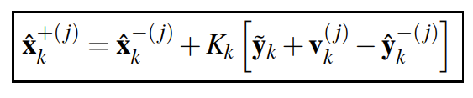
Background: Ensemble Kalman Filter
The EnKF works on the premise of using a collection of state vectors, i.e., the ensembles, to replace the covariance matrix with the sample covariance. [2]
Dynamic model
Kalman Gain
Cross covariance between states and measurements
Measurement covariance
Kalman update with added noise*
* Noise is added because using the same measurement on each ensemble introduces spurious correlation [7]

Slide 7
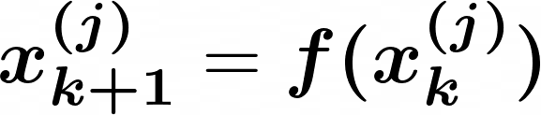
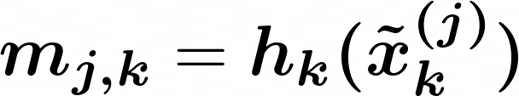
Approach: Filter Application
Goal: Use the EnKF with a vortex model to estimate the unsteady flow over the plate [3, 4].
Initial Definitions:
State model of n blobs
Vortex propagation and accumulation
Vortex surface pressure calculation
Notes:
GO INTO WHAT F IS!!!

Slide 8
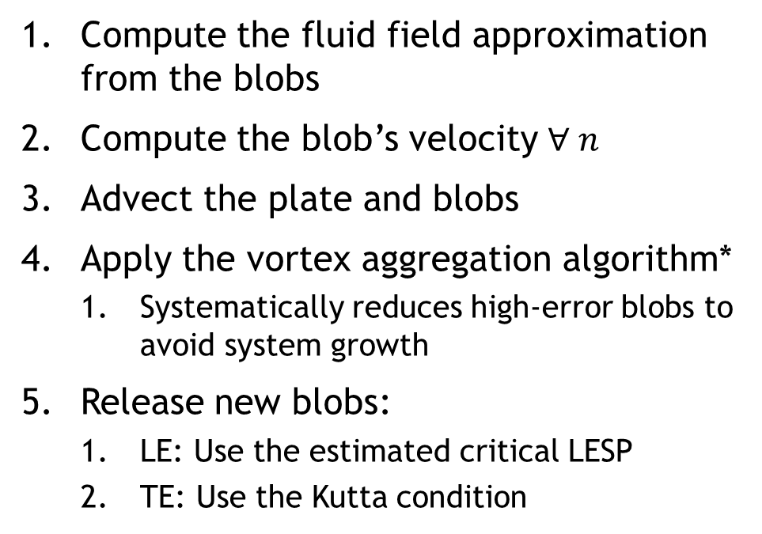
Approach: Filter Application
Goal: Use the EnKF with a vortex model to estimate the unsteady flow over the plate [3, 4].
Compute the fluid field approximation from the blobs
Compute the blob’s velocity $∀ n$
Advect the plate and blobs
Apply the vortex aggregation algorithm*
Systematically reduces high-error blobs to avoid system growth
Release new blobs:
LE: Use the estimated critical LESP
TE: Use the Kutta condition
Initial Definitions:
State model of n blobs
Vortex propagation and accumulation
Vortex surface pressure calculation

Slide 9
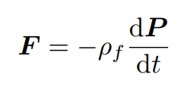
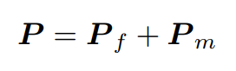
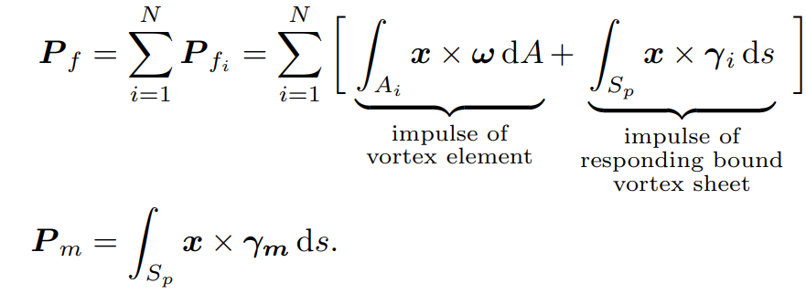
Approach: Filter Application
Goal: Use the EnKF with a vortex model to estimate the unsteady flow over the plate [3, 4].
Initial Definitions:
Force on the plate is from the change in impulse of the fluid
State model of n blobs
Vortex propagation and accumulation
Vortex surface pressure calculation
Force is used to back out pressure distributions!
Notes:
Pf = the impulse of the free vortex elements and their corresponding bound vortex sheet
Pm = the impulse of the bound votex sheet created in response to the rigid body motion

Slide 10
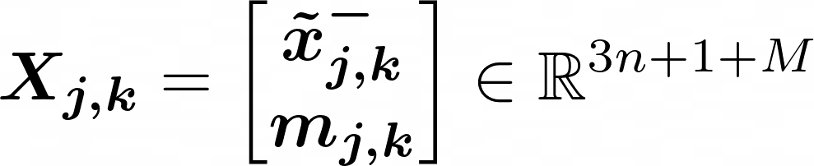
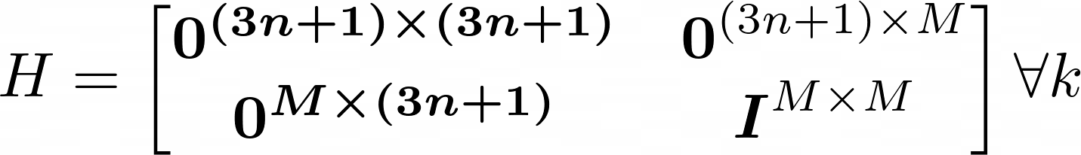
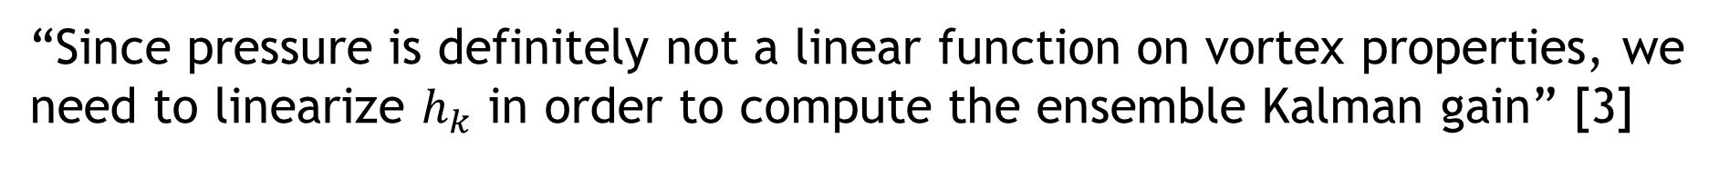
Approach: Filter Application
“Since pressure is definitely not a linear function on vortex properties, we need to linearize $h_{k}$ in order to compute the ensemble Kalman gain” [3]
Augment the state matrix with measurements
Notes:
GO INTO WHAT F IS!!!

Slide 11
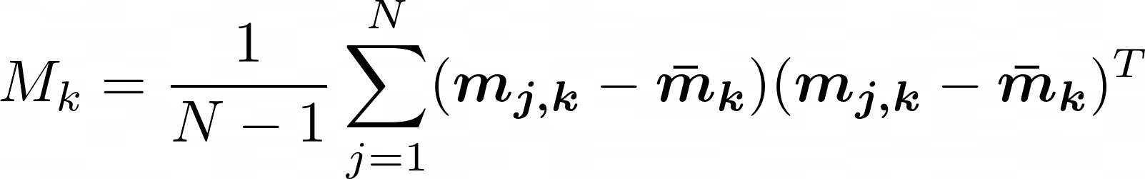
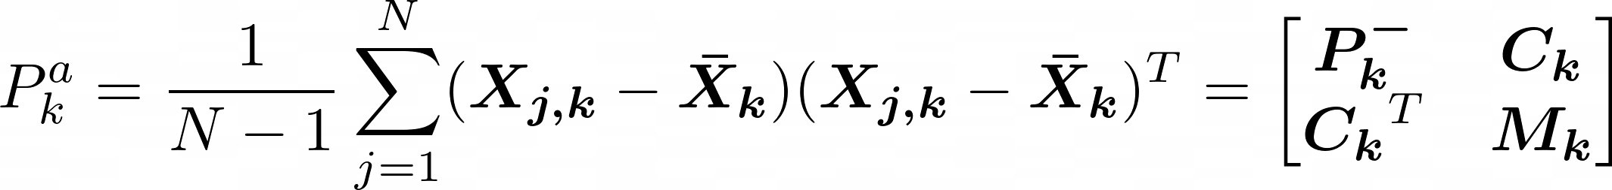
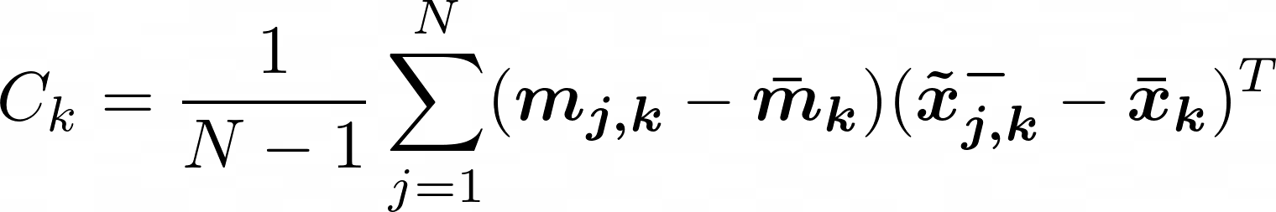
Approach: Filter Application
“Since pressure is definitely not a linear function on vortex properties, we need to linearize $h_{k}$ in order to compute the ensemble Kalman gain” [3]
Define covariances and cross covariances
Notes:
GO INTO WHAT F IS!!!

Slide 12
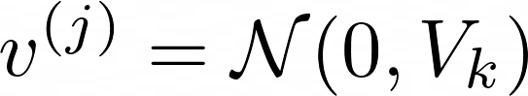
Approach: Filter Application
“Since pressure is definitely not a linear function on vortex properties, we need to linearize $h_{k}$ in order to compute the ensemble Kalman gain” [3]
Notes:
GO INTO WHAT F IS!!!

Slide 13
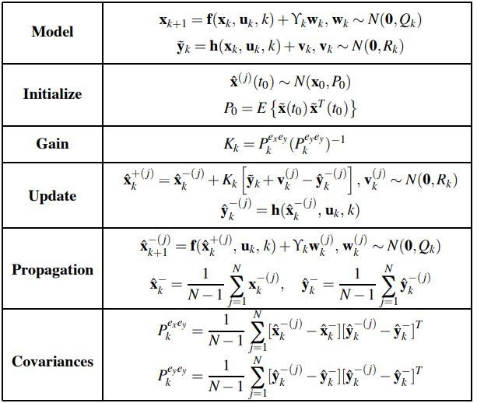
Approach: Filter Application, Comparison to Crassidis
Do we need to linearize h?
The derivation in Crassidis uses covariances from the ensembles only – does not include Vk.
The paper’s authors are effectively reducing the gain by adding in variance from linearization
Notes:
GO INTO WHAT F IS!!!

Slide 14
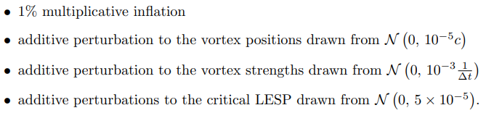
Approach: Covariance inflation
In EnKF’s, the estimated gain is often a poor approximate for the true gain in high dimensional systems [5], leading to downward bias on the estimate of the posterior.
Alleviated with covariance inflation [5, 6]
Notes:
GO INTO WHAT F IS!!!

Slide 15
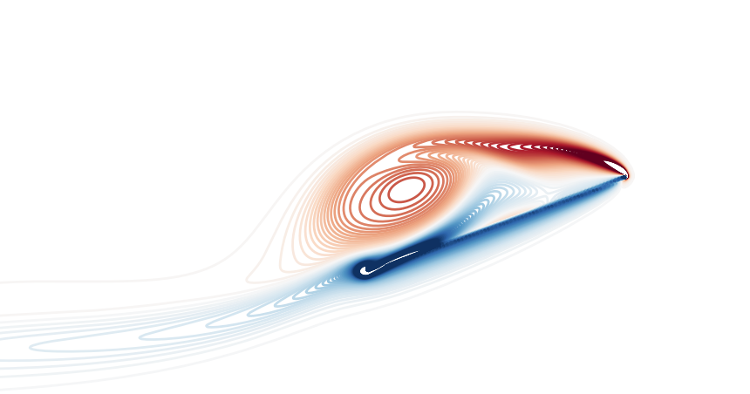
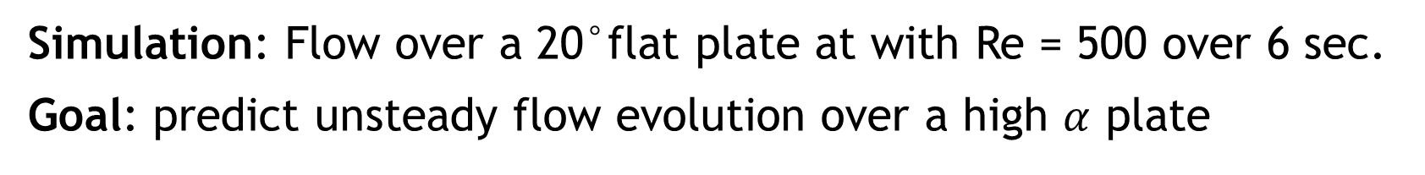
Simulations and Results
Simulation: Flow over a 20°flat plate at with Re = 500 over 6 sec.
Goal: predict unsteady flow evolution over a high $α$ plate
Simulation Cases
Leading edge (LE)
Pulse-Free
Single impulse at t = 3
Two impulse at t = 3 and t = 5
Impulse models a gust or perturbation
Trailing edge (TE)

Slide 16
Simulations and Results
Simulation: Flow over a 20°flat plate at with Re = 500 over 6 sec.
Goal: predict unsteady flow evolution over a high $α$ plate
Simulation Cases
Filtering Investigation
Pulse-Free
Single impulse at t = 3
Two impulse at t = 3 and t = 5
No covariance inflation
Multiplicative inflation
Additive + Mult. inflation

Slide 17
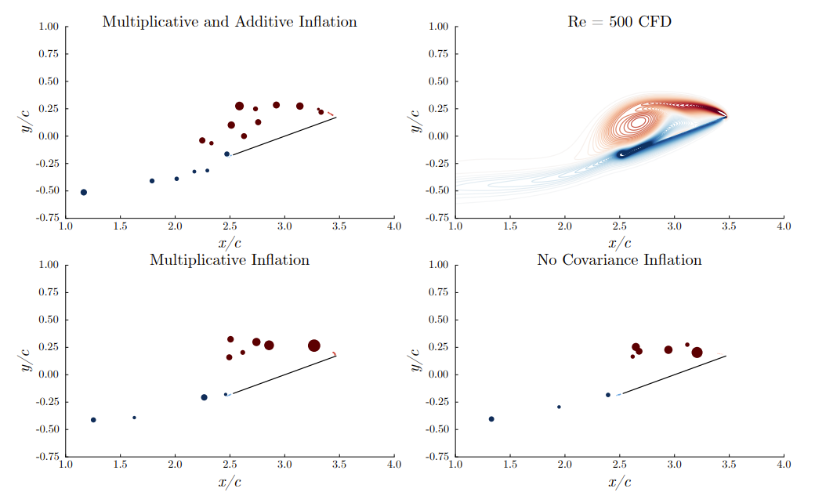
Simulations and Results: Pulse-free
The authors first compared the 3 different filtering approaches to a high-fidelity CFD “ground truth” over the simulation time (N = 50).
Right: t = 3 sec
Blob filtering and estimation with the EnKF, t = 3 sec.

Slide 18
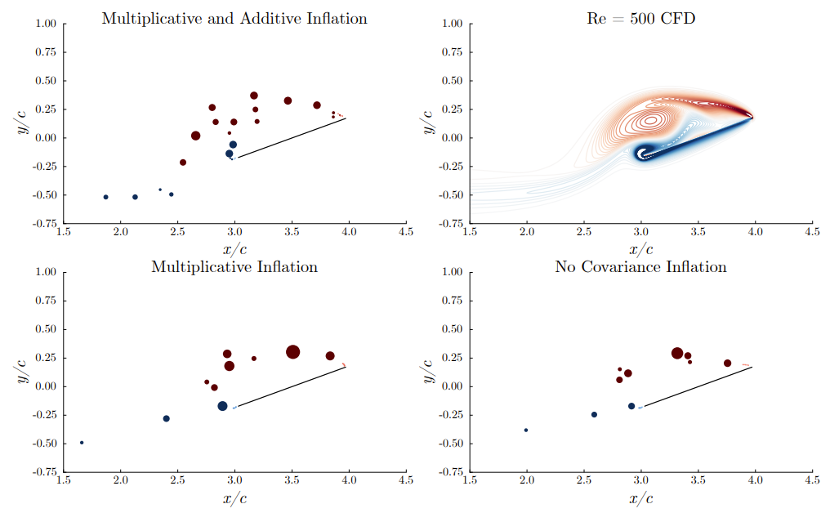
Simulations and Results: Pulse-free
The authors first compared the 3 different filtering approaches to a high-fidelity CFD “ground truth” over the simulation time (N = 50).
Right: t = 3.5 sec
Blob filtering and estimation with the EnKF, t = 3.5 sec.

Slide 19
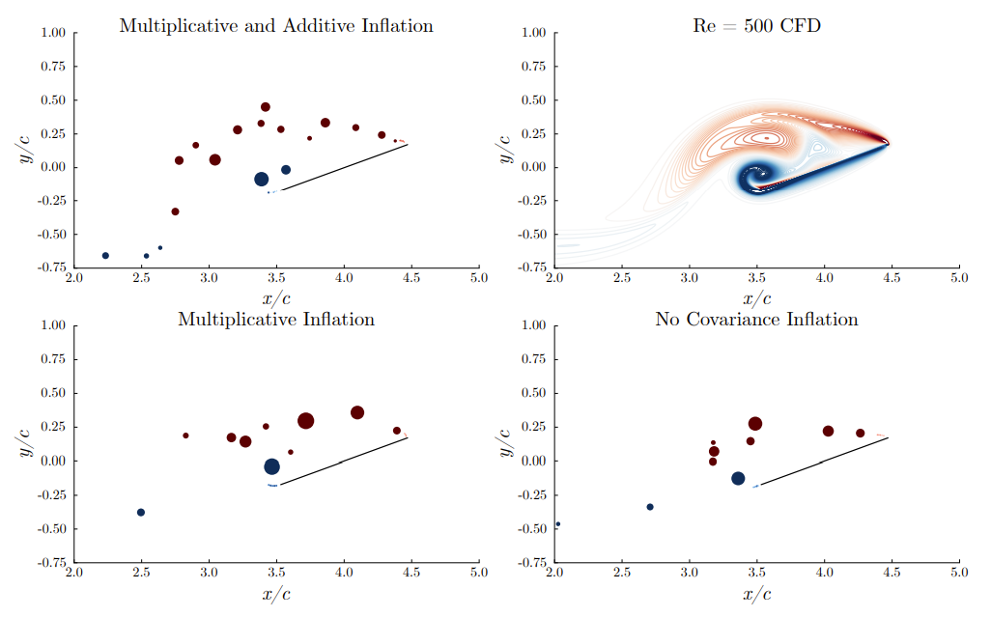
Simulations and Results: Pulse-free
The authors first compared the 3 different filtering approaches to a high-fidelity CFD “ground truth” over the simulation time (N = 50).
Right: t = 4 sec
Blob filtering and estimation with the EnKF, t = 4 sec.

Slide 20
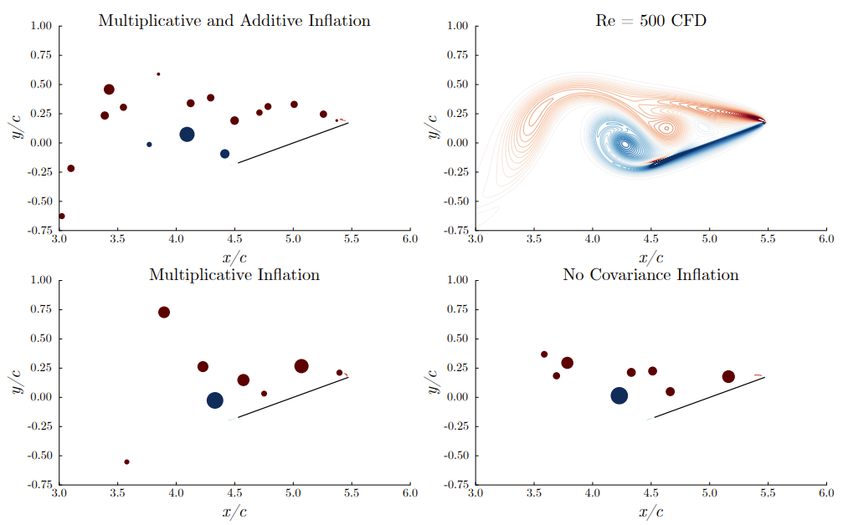
Simulations and Results: Pulse-free
The authors first compared the 3 different filtering approaches to a high-fidelity CFD “ground truth” over the simulation time (N = 50).
Right: t = 5 sec
Blob filtering and estimation with the EnKF, t = 5 sec.

Slide 21
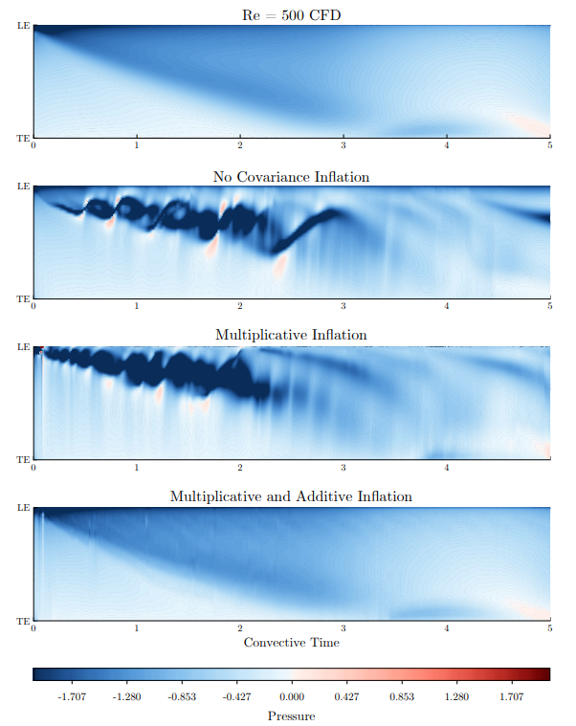
Simulations and Results: Pulse-free
LE
The authors then compared the pressure distribution along the plate – this is critical to estimate in most applications!
TE
Estimated plate pressure distributions across simulation time

Slide 22
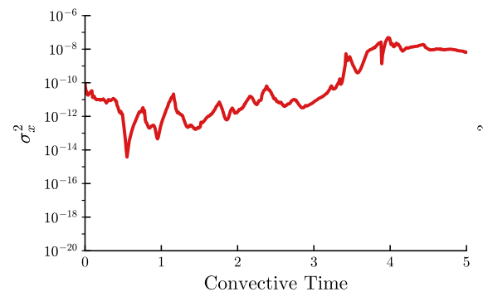
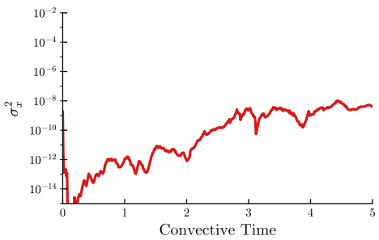
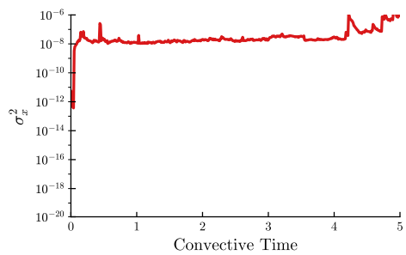
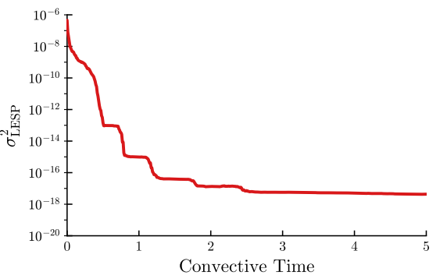
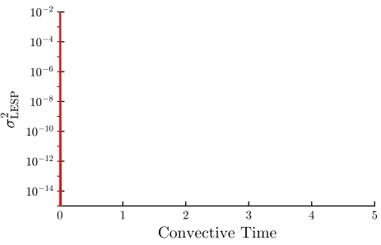
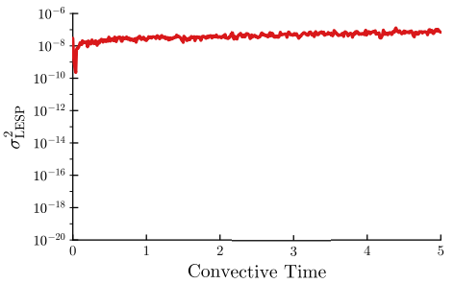






Simulations and Results: Pulse-free
The authors then present the ensemble covariances for the 3 cases.
No inflation
Mult. inflation
Mult. + Additive inflation
$${10}^{−10}$$
$${10}^{−8}$$
$$σ_{x}^{2}$$
$${10}^{−8}$$
$$σ_{LESP}^{2}$$
$${10}^{−16}$$

Slide 23
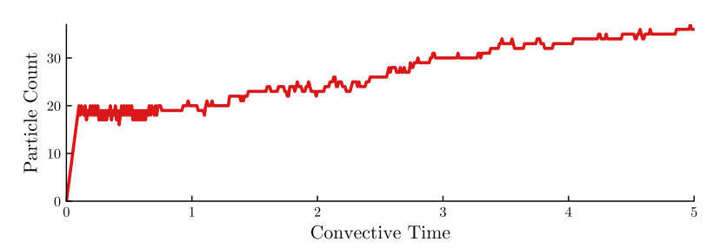
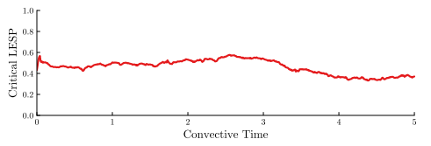
Simulations and Results: Pulse-free
Finally, the authors plot particle count and the estimated critical LESP
Mult. + Additive inflation
Number of blobs through the simulation under additive and multiplicative noise
The estimated critical LESP through time shows a roughly constant value – agrees with [7] that critical LESP is mostly dependent on Reynolds number!

Slide 24
Simulations and Results: Pulse-free
Some initial conclusions:
The collapse of LESP covariance and crisscrossing of pressure distribution means the EnKF is ignoring measurement information without Cov. Inf.
Further, the LESP mismodeling means the filter can only move existing blobs to match pressure distributions – this is not sufficient!
The filter can successfully operate with reduced dimensionality and keeps the number of blobs generally stable ✓

Slide 25
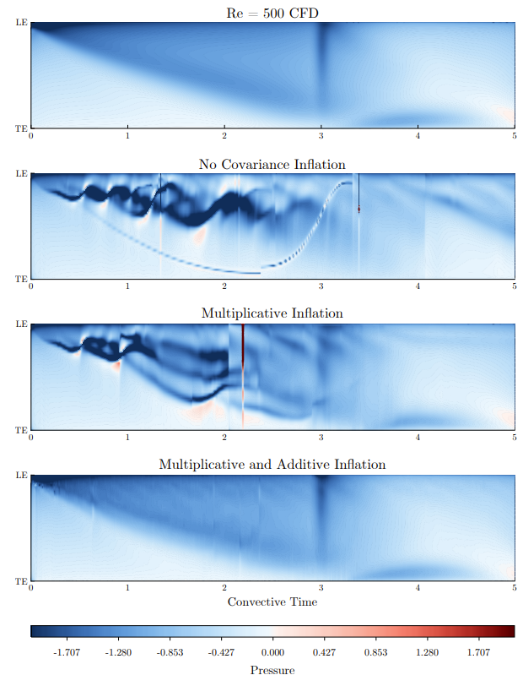
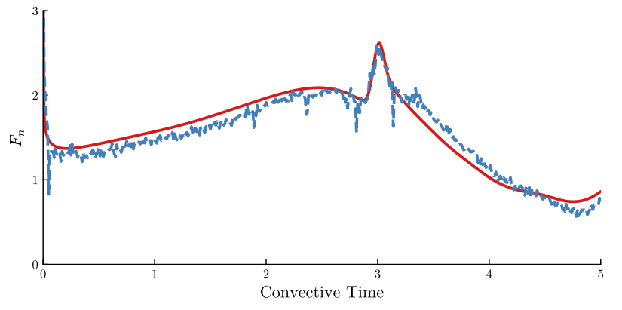
Simulations and Results: Single Pulse
An impulse is applied to the plate at t = 3 sec. Qualitative results validate the pulse-free case.
CFD
Filter
Force on the plate under additive and multiplicative noise

Slide 26
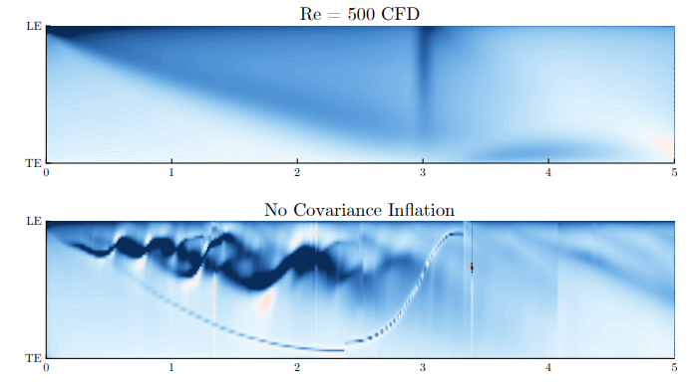
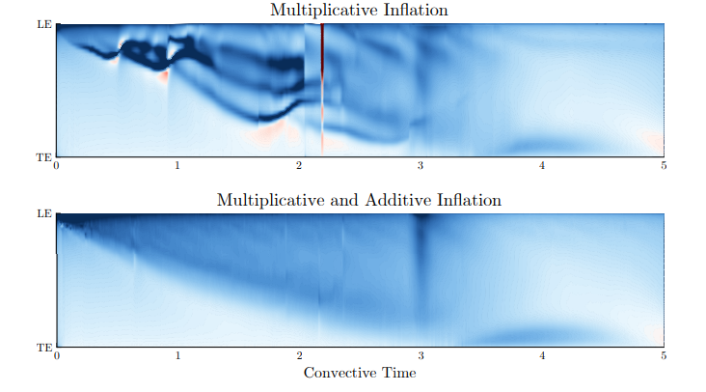
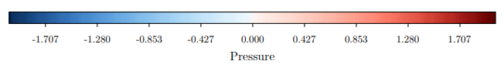
Simulations and Results: Single Pulse

Slide 27
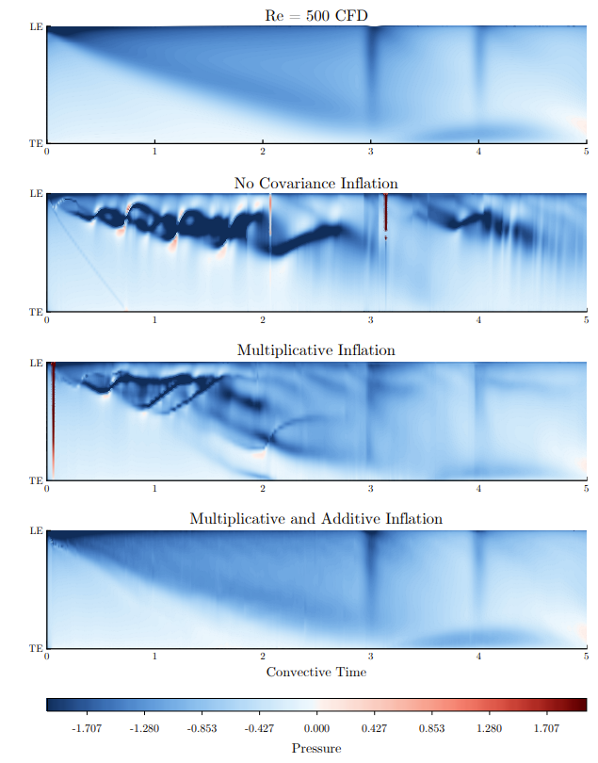
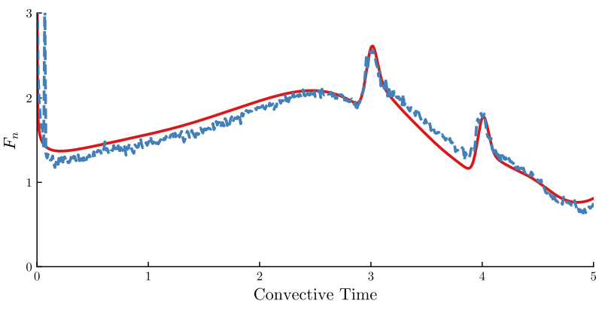
Simulations and Results: Two Pulses
An impulse is applied to the plate at t = 3 and t = 5 sec. Qualitative results validate the pulse-free and the single pulse case.
CFD
Filter
Force on the plate under additive and multiplicative noise

Slide 28
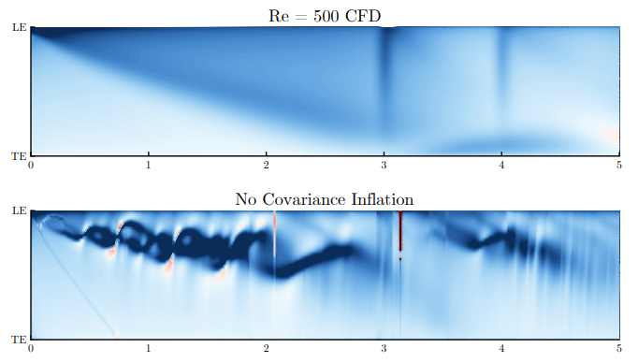
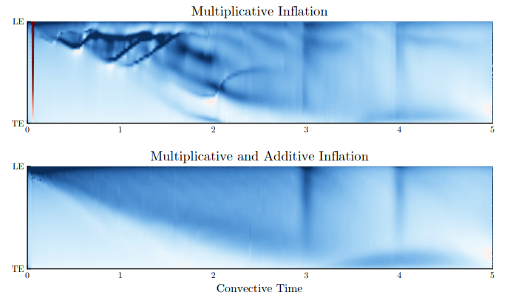
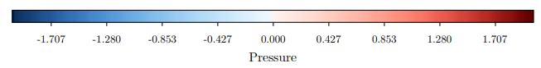
Simulations and Results: Two Pulses

Slide 29
Conclusions and critique
Conclusions:
Vortices can be estimated from pressure data on a plate using an EnKF algorithm and used to estimate the full state of the flow.
The estimation requires covariance inflation to correctly release vortices
Estimation works under some initial unsteady validation tests.
Critique:
Paper demonstrates limited error analysis
Needs computation time or algorithm analysis to compare against existing methods
Comparison to KF (i.e., computational cost of taking the covariance inverse)
Covariance figures are difficult to compare!

Slide 30
Future work
Investigate Crassidis’ formulation of EnKF to check if cov. inf is needed.
Critical LESP is key to correct modeling – investigate including more sophisticated critical LESP models to improve estimation.
Explore using methods of directly approximating the flow field
Potential advantage: blob propagation, aggregation, and measurement is costly! Measurement points must be estimated as well in author’s formulation.

Slide 31
Sources Cited
[1] Ramesh, Kiran & Gopalarathnam, Ashok & Granlund, Kenneth & Ol, Michael & Edwards, Jack. (2012). Theoretical Modeling of Leading Edge Vortices Using the Leading Edge Suction Parameter. 30th AIAA Applied Aerodynamics Conference 2012. 10.2514/6.2012-3027.
[2] Crassidis, J. L., & Junkins, J. L. (2004). Optimal estimation of dynamic systems. Chapman and Hall/CRC.
[3] Darakananda, Darwin & Eldredge, Jeff & De Castro da Silva, Andre Fernando & Colonius, Tim & Williams, David. (2018). EnKF-Based Dynamic Estimation of Separated Flows with a Low-Order Vortex Model. 10.2514/6.2018-0811.
[4] Darakananda, Darwin & Eldredge, Jeff & Colonius, Tim & Williams, David. (2016). A Vortex Sheet/Point Vortex Dynamical Model For Unsteady Separated Flows. 10.2514/6.2016-2072.
[5] Katzfuss, M., Stroud, J. R., & Wikle, C. K. (2016). Understanding the Ensemble Kalman Filter. The American Statistician, 70(4), 350–357. https://doi.org/10.1080/00031305.2016.1141709
[6] Jeffrey S. Whitaker and Thomas M. Hamill. (2012) Evaluating Methods to Account for System Errors in Ensemble Data Assimilation. Monthly Weather Review, 140(9):3078–3089
[7] Kiran Ramesh and Ashok Gopalarathnam. Theoretical Modeling of Leading Edge Vortices Using the Leading Edge Suction Parameter. AIAA Appl. Aerodyn. Conf., pages 1–16, 6 2012

Slide 32


Appendix 1: Vortex Aggregation Model
At each time step:

Slide 33




Appendix 2: Pulse critical LESP estimation + blob count
Single Pulse
Double Pulse

